Slide 1



P798 HIGH CLOUD AIRLINES
Indian Airport
GROUP NO.1

Slide 2

Today’s Agenda
01
Purpose of Project
02
Recap
03
Process
04
05
Summary
Insight’s

Slide 3
Analytic’s Team
Recap
Recap
Manaswini Pilli
Pawan Dilip Gaikwad
Harsh Kalbande
Purpose of Project
Ruchitha Karuturi
Neelima Deepthi Kocharla
Insight’s
Bhoomika Gowda
Suhani
Bhoomika

Slide 4

Airport
PURPOSE OF THE PROJECT
The purpose of this data analysis project is to leverage historical and operational data from P798 High Cloud Airlines to gain actionable insights that can help improve operational efficiency, enhance customer satisfaction, and optimize key business areas such as flight schedules, pricing strategies, and resource allocation. By analyzing various datasets, such as flight performance, customer feedback, weather conditions, and operational metrics, this project aims to identify trends, uncover potential inefficiencies, and provide data-driven recommendations for better decision-making.

Slide 5

PROCESS
DATA UNDERSTANDING
Recap
Recap
DATA CLEANING
Purpose of Project
DATA MODELLING
DATA ANALYSIS
Insight’s
UNCOVER INSIGHTS
Bhoomika

Slide 6

RECAP
Impact: Enhanced operational efficiency, cost reduction, and improved customer loyalty for P798 High Cloud Airlines.
Data-Driven Decisions: Empowered the airline to make informed, strategic decisions based on predictive models and trends.
Future Growth: Data insights provide a foundation for continuous improvement and scaling in line with market demands.
Strategic Focus: Focus on leveraging analytics to stay competitive and meet evolving customer expectations.

Slide 7
INSIGHTS
LOAD FACTOR ANALYSIS
T . he history of airports dates back over a century, from the early days of aviation to the present, wherethey have become crucial transportation hubs connecting people and goods across the globe, evolving with new technologies and innovations shaping their future.
DATE METRICS
YEAR- The overall load factor indicate a profitable and efficient airline operation.
MONTH- Airline demand follows a seasonal trend, peaking in summer months..
QUARTER- Load factors peak in Q2 & Q3 due to vacation seasons, while Q1 & Q4 show lower demand due to post-holiday and off-peak periods.
Provides a breakdown of flight operations:
Quarter and month classification
Financial month and quarter mapping
Weekday analysis to observe flight patterns
AIRLINE LOAD FACTOR
PASSENGER COUNT BY AIRLINE
The competition among airlines is fairly balanced, with several carriers maintaining similar performance levels.
Airlines with lower load factors may need to improve route planning and pricing strategies to increase seat utilization
Lists airlines with the highest passenger transport counts.
Delta Airlines had the highest passenger traffic.
Helps identify major market players.

Slide 8

BUSIEST ROUTES
The city pairs are key hubs for airline operations.
WEEKDAY VS WEEKEND PERFORMANCE
Flights are more efficient on weekdays. And Demand is lower on weekends.
Includes carrier, origin and destination details which helps identify regional trends.
AIRLINE ROUTE DETAILS
Most airline operations focus on specific routes or categories
AIRLINE GROUPING

Slide 9
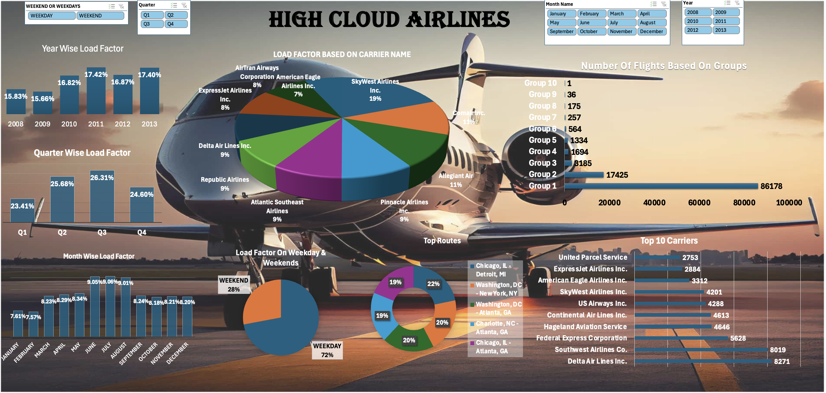
Excel DashBoard

Slide 10
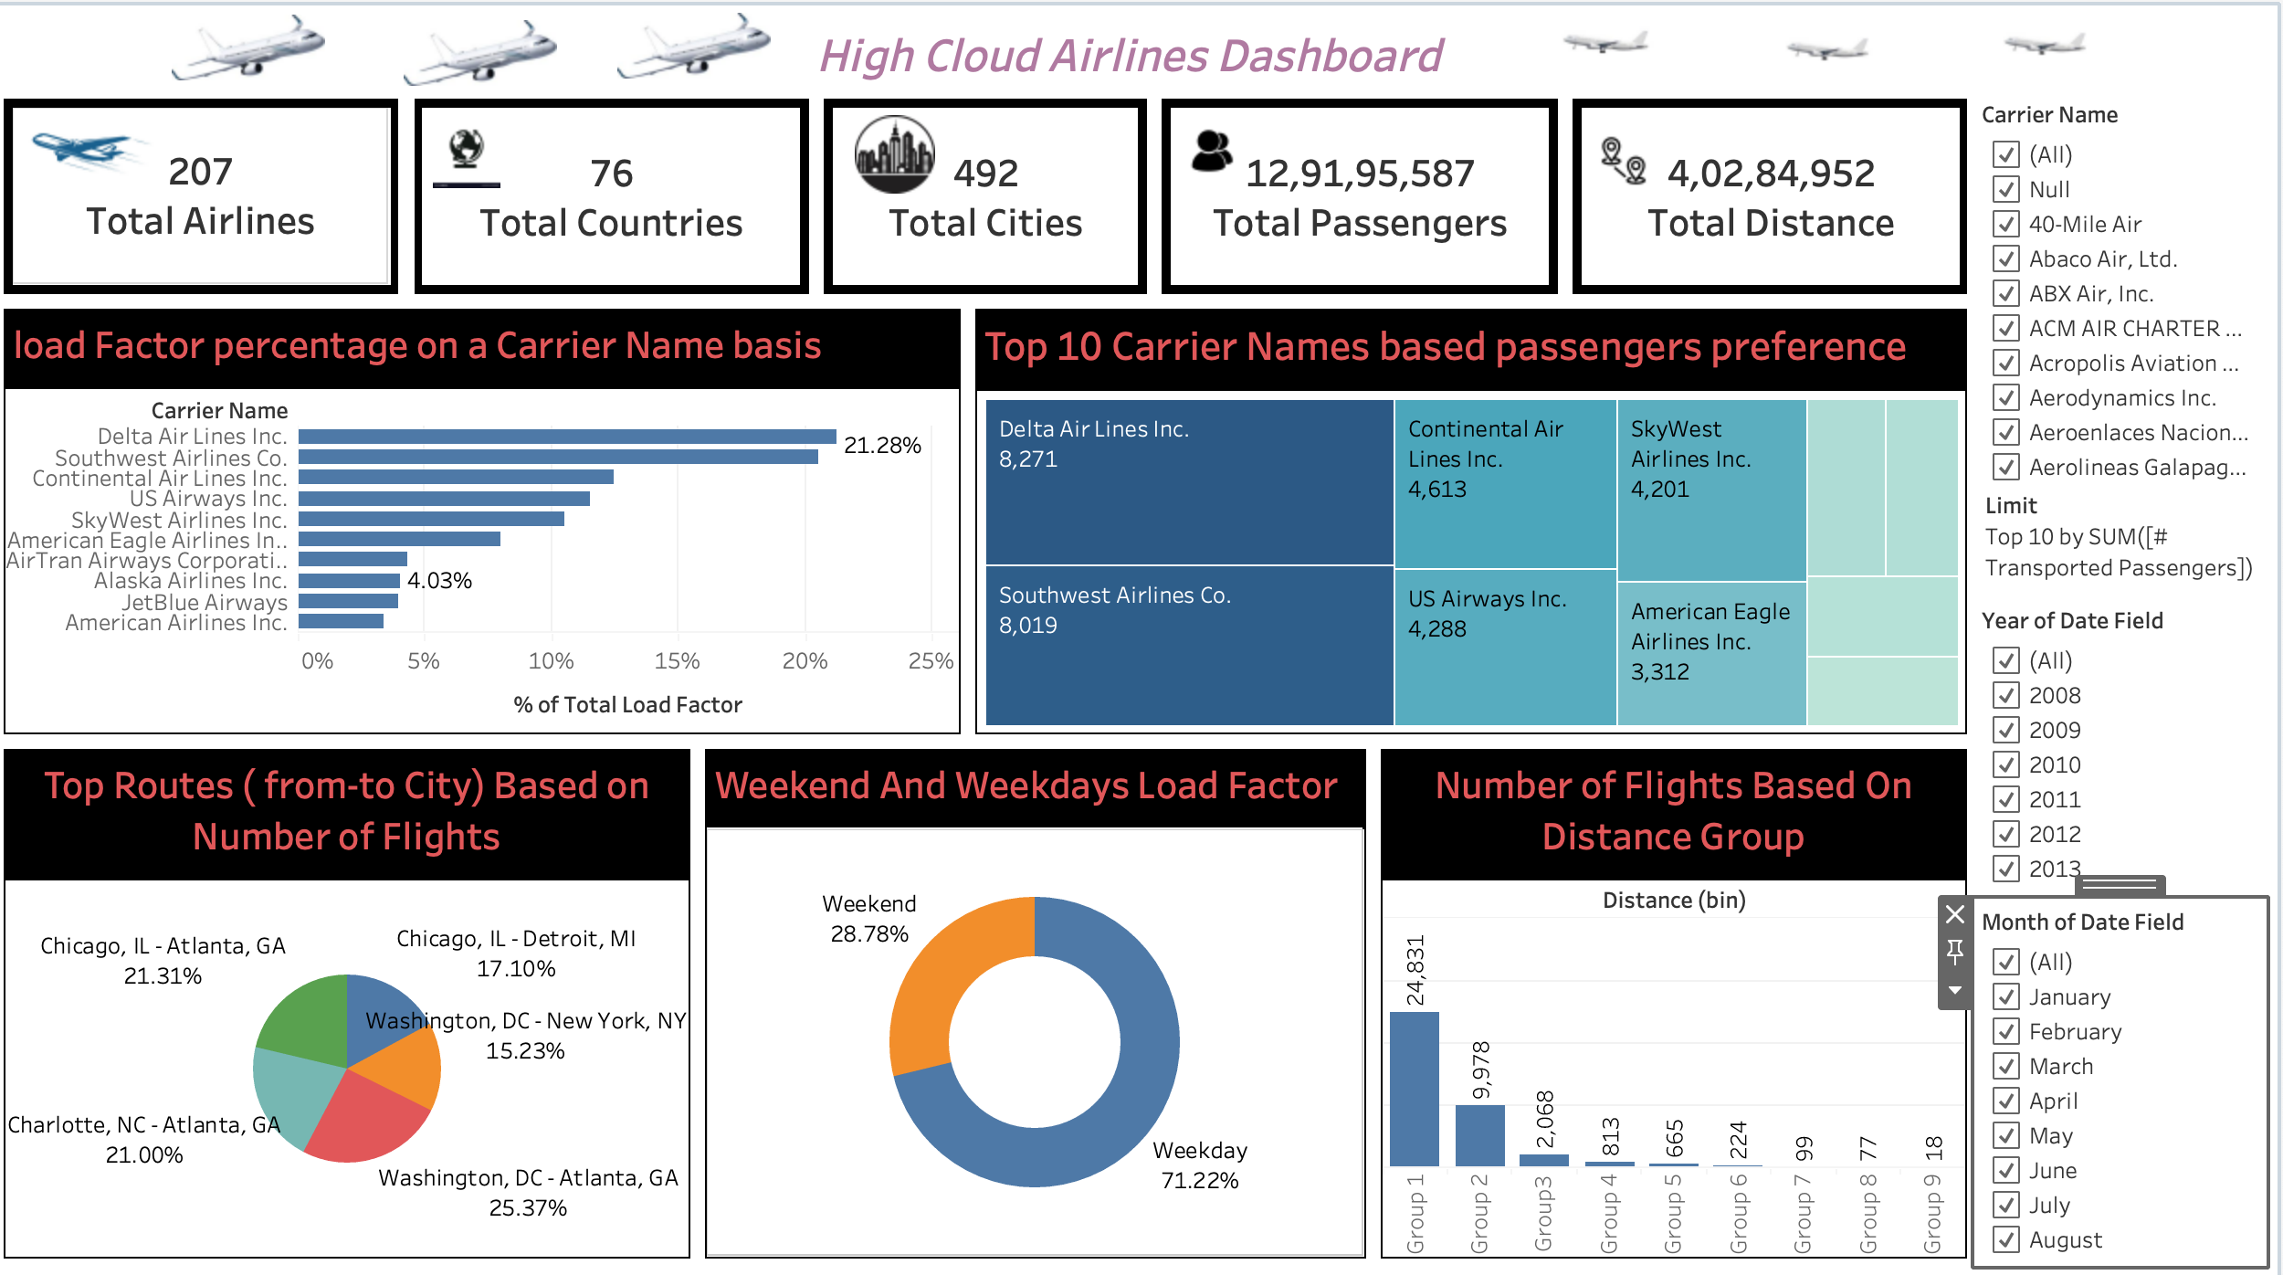
Tableau DashBoard
Airport

Slide 11
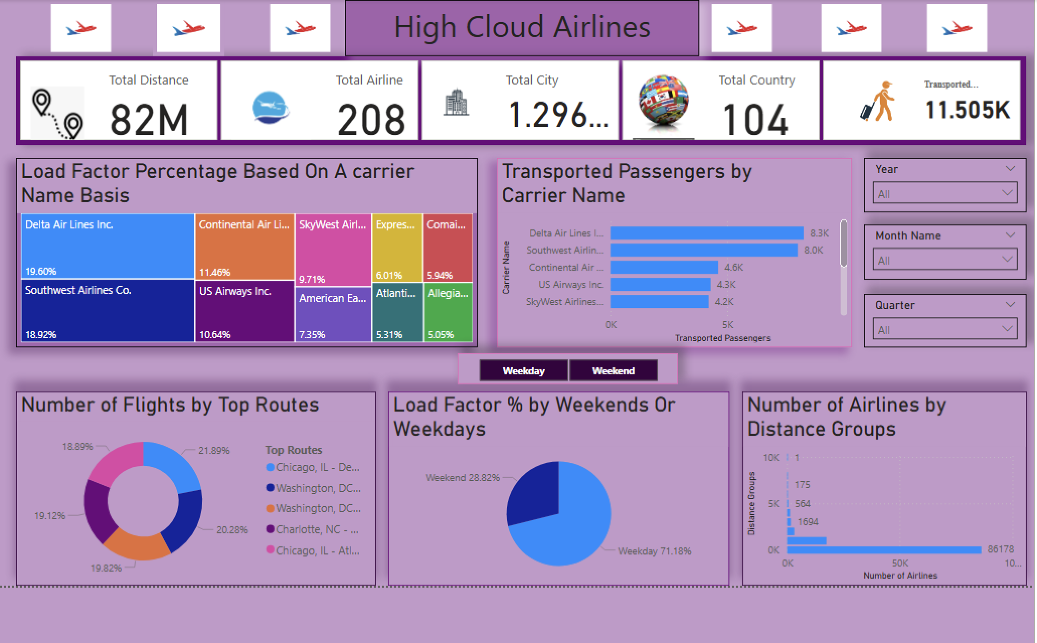
Power BI DashBoard

Slide 12

SUMMARY
Analyzing on-time performance and identifying factors that contribute highest passenger count.
Exploring customer satisfaction metrics and understanding drivers of passenger loyalty.
Predicting future demand trends to optimize flight schedules and pricing models.
Providing actionable insights to improve operational efficiency, reduce costs, and enhance the overall passenger experience.

Slide 13

"Air travel is the safest form of travel."

Slide 14


